Slide 1

Teacher: Nguyễn Đức Giang
Student: Nguyễn Tuấn Minh
Student ID: BKC12345
Class: BTECD06K12

Slide 2

1. Server Technologies and Management Services

Slide 3

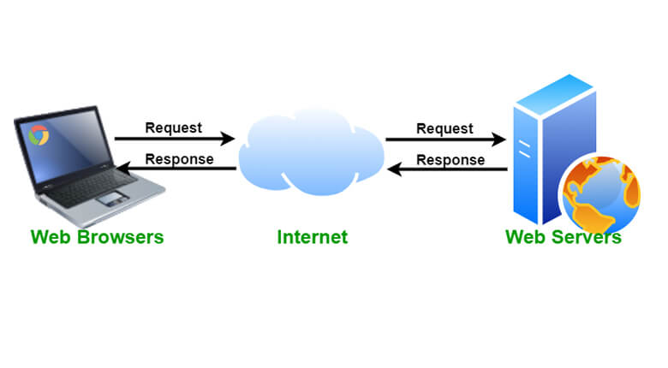
How do website work
For the website to work correctly, the following items are required:
• Clients: Internet-connected PCs and web access software used by web users.
• Sever: Computers that store websites or software for usage by consumers.
Websites work as follows:
• Respond to client inquiries
• Public Reactions
• Install on a computer referred to as a host.
• Provide the client with information

Slide 4

Define, Purpose of DNS
DNS (Domain Name System) or domain name resolution system, can be explained as a system that helps humans and computers "communicate" with each other more easily.
• Convert domain names to IP addresses
• Find and identify services on the
Internet
• Humans are easier to work with than
numbers.

Slide 5
Types of DNS server
Recursive resolvers
• The first stop in a DNS query serves
• Acts as a go-between between a client
and a DNS nameserver.
TLD nameservers
• Keeps track of all domain names that have a similar domain extension
Root nameservers
• The initial stop in a recursive resolver's
search for DNS records
• The Internet Corporation for Assigned
Names and Numbers (ICANN) is in
charge of it
Authoritative nameservers
• When the resolver receives a response
from a TLD name server, the answer
directs the resolver to an authoritative
name server
• The final stop on an IP address's trip

Slide 6
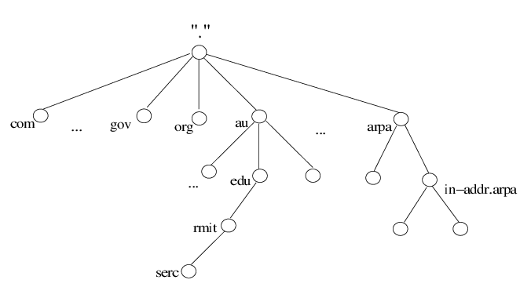
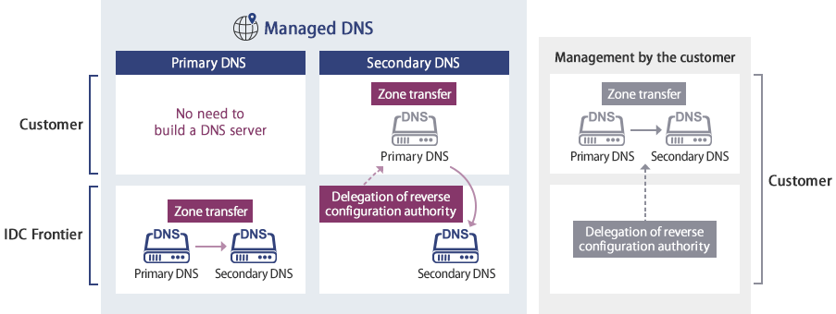
How domain names are organized and managed
Organized
1) Root Level
2) Top Level Domains
3) Second Level Domains
4) Sub-Domain
5) Host
Managed
• Domains are administered by a global network of domain
registrars and databases
• DNS is a mapping service that connects human-readable
computer hostnames to the IP addresses used by networking devices

Slide 7

Communication protocol
Definition:
• Rules and formats for digital messages are
described in formal terms.
• Used for data transport over the internet.
• Required for message exchange inside or
across computer systems
Purpose:
• Used for data transmission via the
Internet.
• Choosing the appropriate channel or
medium bandwidth for each form of
communication
• Identifying the operating systems that will
be utilized to connect with the devices

Slide 8
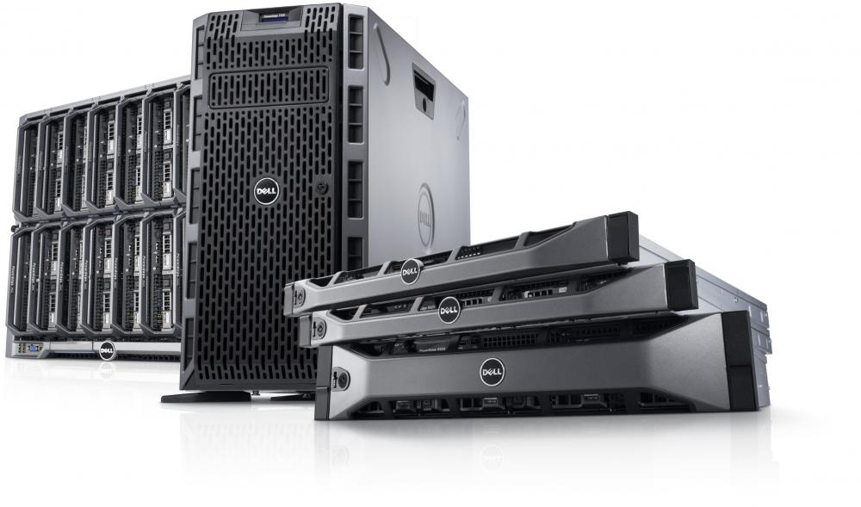

Web Server Software
Server hardware
Definition:
• A type of software that is meant to be run and maintained on a computer server
• Provides and facilitates the use of underlying server processing capability with a wide range of high-end computing applications
and tasks
Purpose:
• On the server, operate and manage
• Publish the files to other computers
Definition: Physical computers operate
constantly for an extended period,
increasing user productivity.
Purpose: Share data and complete tasks
to keep your workflow running smoothly
and your productivity high.

Slide 9
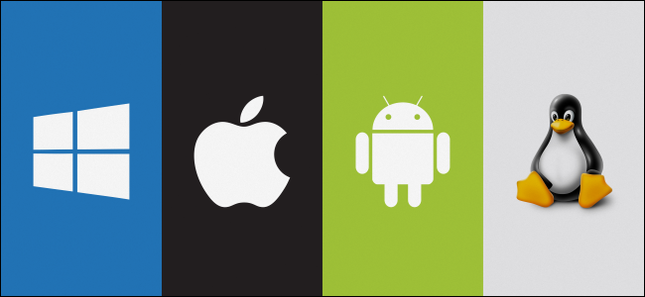
Server Operating System
Definition:
• Is a type of operating system that is specially
built to work on servers.
• Only intended for use on servers
• Serve the requests of the network's client
computers
Purpose:
• Manage assets, access, memory, and so on.
• Support for web servers, mail servers, and so
on.
The most popular server operating systems:
• Windows Server, MacOS, Linux, ...

Slide 10
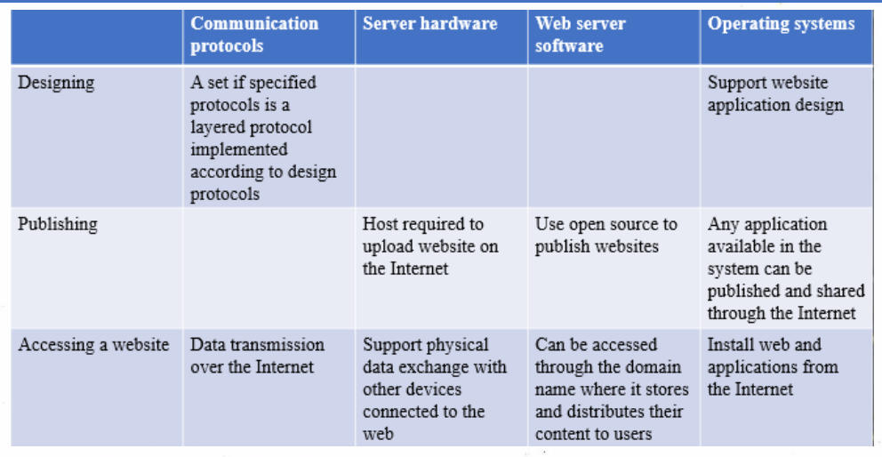
Relationship of 4 elements
• Communication protocols allow devices to communicate with one
another. Devices require a transmitter and a receiver to convey and
retrieve data to communicate with one another.
• Server hardware is used to store, process, retrieve, and share data
amongst computers on a network.
• The operating system is the heart of the computer, assigning duties to
server components.
• The operating system, hardware, and internal data of the server are all
managed by the webserver software.

Slide 11
2. Website Technology, Tools and Software

Slide 12
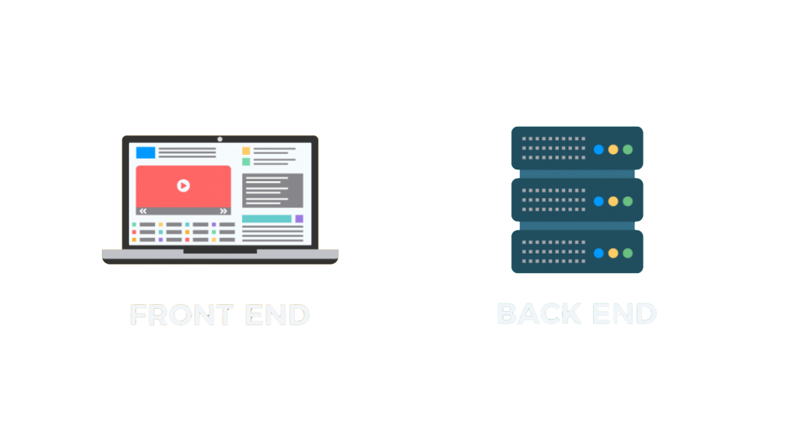
• A graphical user interface
• Enhance the attractiveness
• Watch and engage (static)
• Collect user feedback
• Send to the backend by protocol
• Developers create the functionality of a
website.
• The web framework includes languages
such as ASP.NET MVC and others.
• Database server (MS SQL, MySQL, or
Oracle)
• Server-side languages include C#, PHP, Java,
JSP, Python, ASP.NET, and more.

Slide 13
Relationship between front-end,
back-end, application layer and
presentation layer
Relationship between
front-end and back-end
• The client-side of the program is referred to as the front-end.
• The front-end is the section of the website that users can view and
interact with.
• The server-side of the program is referred to as the back-end.
• Everything that happens behind the scenes is referred to as the back-end. It receives data from the front-end and performs the
necessary operations.
Front-end and presentation layer:
• Create user interface, presentation
classes.
• Data transfer and reception from the
presentation layer
• Data transfer to the application layer
• Translation
• Data should be sent to the application
laye
Back-end and presentation layer:
• The program is interacted with by the
users.
• The operation of the website
• Collect data

Slide 14
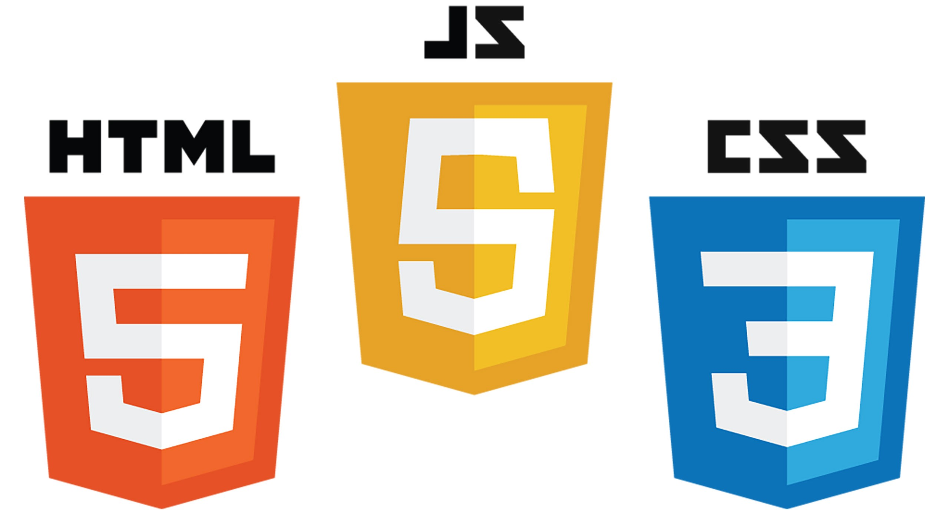
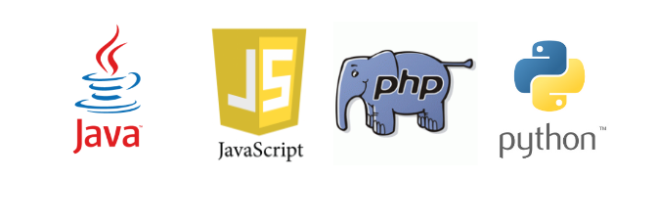
Front-end technologies
Back-end technologies
Definition:
• A form of "client-side" development
• focuses on the first thing a consumer sees when they open their browser or application
• Front-end development determines a website's style and feel.
Front-end languages:
• HTML, CSS, Javascript
Definition:
• Back-end development refers to the development of
an application's server-side.
• In most cases, the back-end includes a server, an
application, and a database.
• The back-end work is hidden from view, but the code
is responsible for delivering database data to the
browser.
Back-end languages:
• Java, Python, PHP, Ruby on rails. .Net

Slide 15

CMS
Definition: software that enables users to create, maintain, and alter website content without the requirement for specific technical skills.
How to Create a Website Using a Content Management System (CMS):
Purchase or hire a web hosting and a domain name
Install your content management system on your web server
Configure the content management system to control how your site looks and performs
Begin writing material using the interface of the content management system.

Slide 16

Online Website Creation Tools
Most themes are created in such a manner that what you see is precisely what you get.
Colors and typefaces can be altered, but the layout remains fairly consistent.
Example: WordPress and WIX

Slide 17
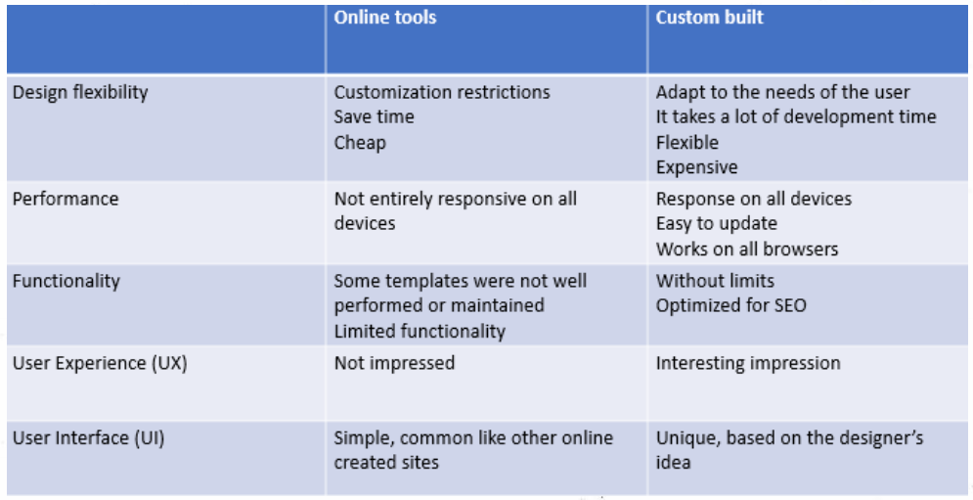
Differences between online website creation tools and custom-build sites
You are authorized and encouraged to use design to represent your company's culture and personality.
A one-of-a-kind arrangement may be shown, changed, and turned into a bespoke location format

Slide 18
3. Evaluate

Slide 19
Analyze the effect of search engines on website performance
Search engine optimization
It’s the process of getting traffic from the free, organic, editorial or natural search results on search engines.All the search engines such as google, yahoo, Bing have primary search results, where web page and othercontent such as videos or local listings are showed and ranked based on what the search engine considersmost relevant to users
Technical solution to improve website index based on SEO
1. Publish Relevant Content
2. Update Content Regularly
3. Metadata
4. Have a link-worthy site
5. Use alt tags

Slide 20

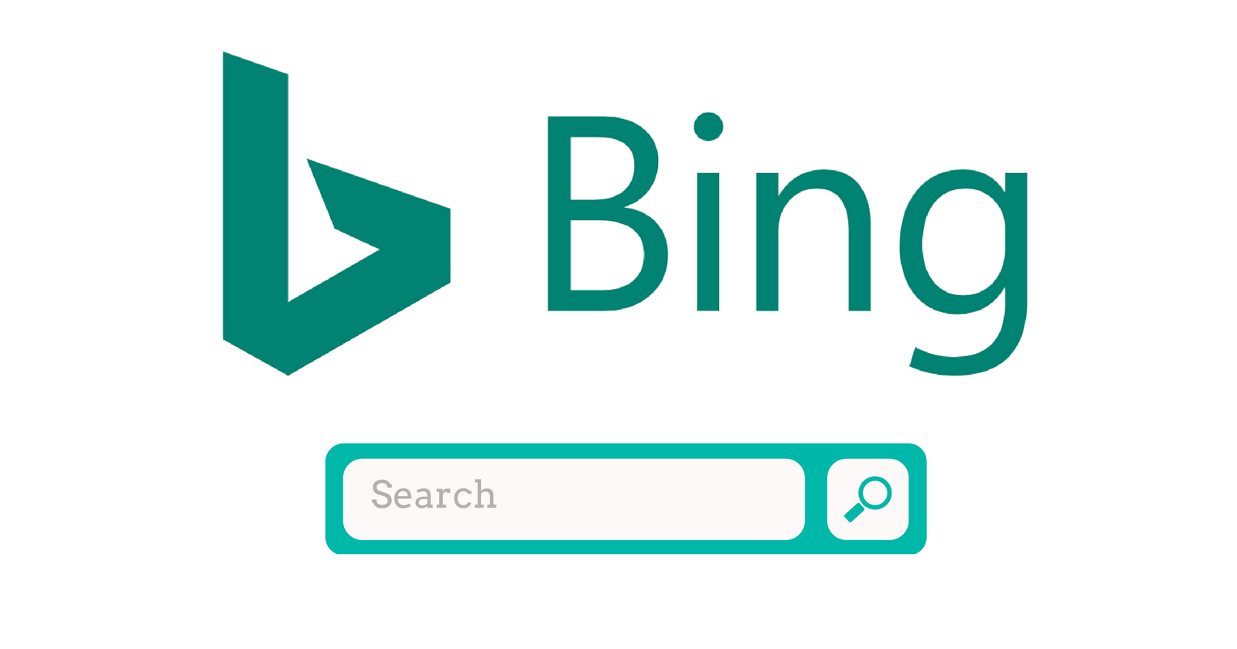
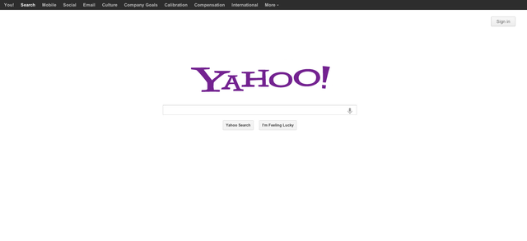



Some Search Engines, Algorithm influance to search engines
Panda Algorithm
Penguin Algorithm
Hummingbird Algorithm

Slide 21
The impact of common web development technologies and framework with regards to website design, function and management
Frameworks are straight forward representation of a programming language, as they are easy to learn and get the job done in no time. However, excessive use of these development tools often eradicates one’s chances of getting the real deal-learning the language with a much more comprehensive overview. Think of it as going to college, only you never really get the thrill of it because you were homeschooled
The fact that most programmers consider frameworks the quickest means to understanding a programming language is often than not a far-fetched idealism. Because most times, they tend to abandon the task of learning how a languages works once the job is done and completed. We all are a victim of this at same point, so there is no denying that
Some frameworks: PHP, Ruby, Python, ...

Slide 22


